Slide 1
Restricting and Sorting Data
Notes:
Schedule: Timing Topic
45 minutes Lecture
30 minutes Practice
75 minutes Total

Slide 2
Objectives
After completing this lesson, you should be able to
do the following:
Limit the rows retrieved by a query
Sort the rows retrieved by a query
Notes:
Lesson Aim
While retrieving data from the database, you may need to restrict the rows of data that are displayed or specify the order in which the rows are displayed. This lesson explains the SQL statements that you use to perform these actions.

Slide 3
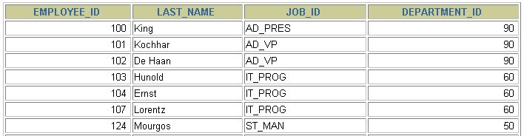

Limiting Rows Using a Selection
EMPLOYEES
…
“retrieve all employees in department 90”
Notes:
Limiting Rows Using a Selection
In the example on the slide, assume that you want to display all the employees in department 90. The rows with a value of 90 in the DEPARTMENT_ID column are the only ones returned. This method of restriction is the basis of the WHERE clause in SQL.

Slide 4
Limiting the Rows Selected
Restrict the rows returned by using the WHERE clause.
The WHERE clause follows the FROM clause.
SELECT *|{[DISTINCT] column|expression [alias],...}
FROM table
[WHERE condition(s)];
Notes:
Limiting the Rows Selected
You can restrict the rows returned from the query by using the WHERE clause. A WHERE clause contains a condition that must be met, and it directly follows the FROM clause. If the condition is true, the row meeting the condition is returned.
In the syntax:
WHERE restricts the query to rows that meet a condition
condition is composed of column names, expressions, constants, and a comparison operator
The WHERE clause can compare values in columns, literal values, arithmetic expressions, or functions. It consists of three elements:
Column name
Comparison condition
Column name, constant, or list of values

Slide 5

Using the WHERE Clause
SELECT employee_id, last_name, job_id, department_id
FROM employees
WHERE department_id = 90 ;
Notes:
Using the WHERE Clause
In the example, the SELECT statement retrieves the name, job ID, and department number of all employees whose job ID is SA_REP.
Note that the job title SA_REP has been specified in uppercase to ensure that it matches the job ID column in the EMPLOYEES table. Character strings are case sensitive.

Slide 6
Character Strings and Dates
Character strings and date values are enclosed in single quotation marks.
Character values are case sensitive, and date values are format sensitive.
The default date format is YYYY-MM-DD.
SELECT last_name, job_id, department_id
FROM employees
WHERE last_name = 'Whalen';
Notes:
Character Strings and Dates
Character strings and dates in the WHERE clause must be enclosed in single quotation marks (''). Number constants, however, should not be enclosed in single quotation marks.
All character searches are case sensitive. In the following example, no rows are returned because the EMPLOYEES table stores all the last names in mixed case:
SELECT last_name, job_id, department_id
FROM employees
WHERE last_name = 'WHALEN';
Oracle databases store dates in an internal numeric format, representing the century, year, month, day, hours, minutes, and seconds. The default date display is DD-MON-RR.
Note: Changing the default date format is covered in a subsequent lesson.
Instructor Note
Some students may ask how to override the case sensitivity. Later in the course, we cover the use of single-row functions such as UPPER and LOWER to override the case sensitivity.

Slide 7
Comparison Conditions
Operator
=
>
>=
<
<=
<>
Meaning
Equal to
Greater than
Greater than or equal to
Less than
Less than or equal to
Not equal to
Notes:
Comparison Conditions
Comparison conditions are used in conditions that compare one expression to another value or expression. They are used in the WHERE clause in the following format:
Syntax
... WHERE expr operator value
For Example
... WHERE hire_date='01-JAN-95'
... WHERE salary>=6000
... WHERE last_name='Smith'
An alias cannot be used in the WHERE clause.
Note: The symbol != and ^= can also represent the not equal to condition.

Slide 8

Using Comparison Conditions
SELECT last_name, salary
FROM employees
WHERE salary <= 3000;
Notes:
Using the Comparison Conditions
In the example, the SELECT statement retrieves the last name and salary from the EMPLOYEES table, where the employee salary is less than or equal to 3000. Note that there is an explicit value supplied to the WHERE clause. The explicit value of 3000 is compared to the salary value in the SALARY column of the EMPLOYEES table.

Slide 9
Other Comparison Conditions
Operator
BETWEEN ...AND...
IN(set)
LIKE
IS NULL
Meaning
Between two values (inclusive),
Match any of a list of values
Match a character pattern
Is a null value

Slide 10
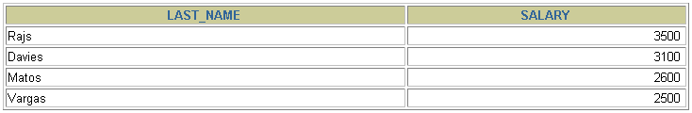
Using the BETWEEN Condition
Use the BETWEEN condition to display rows based on a range of values.
SELECT last_name, salary
FROM employees
WHERE salary BETWEEN 2500 AND 3500;
Lower limit
Upper limit
Notes:
The BETWEEN Condition
You can display rows based on a range of values using the BETWEEN range condition. The range that you specify contains a lower limit and an upper limit.
The SELECT statement on the slide returns rows from the EMPLOYEES table for any employee whose salary is between $2,500 and $3,500.
Values specified with the BETWEEN condition are inclusive. You must specify the lower limit first.
Instructor Note
Emphasize that the values specified with the BETWEEN operator in the example are inclusive. Explain that BETWEEN … AND … is actually translated by Oracle server to a pair of AND conditions: (a >= lower limit) AND (a <= higher limit). So using BETWEEN … AND … has no performance benefits, and it is used for logical simplicity.
Demo: 2_betw.sql
Purpose: To illustrate using the BETWEEN operator.

Slide 11
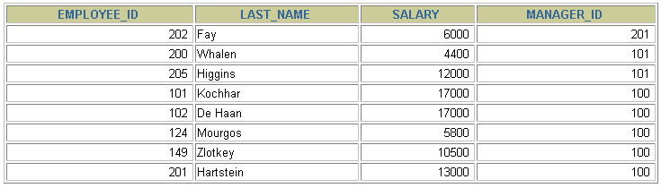
Using the IN Condition
Use the IN membership condition to test for values in
a list.
SELECT employee_id, last_name, salary, manager_id
FROM employees
WHERE manager_id IN (100, 101, 201);
Notes:
The IN Condition
To test for values in a specified set of values, use the IN condition. The IN condition is also known as the membership condition.
The slide example displays employee numbers, last names, salaries, and manager’s employee numbers for all the employees whose manager’s employee number is 100, 101, or 201.
The IN condition can be used with any data type. The following example returns a row from the EMPLOYEES table for any employee whose last name is included in the list of names in the WHERE clause:
SELECT employee_id, manager_id, department_id
FROM employees
WHERE last_name IN ('Hartstein', 'Vargas');
If characters or dates are used in the list, they must be enclosed in single quotation marks ('').
Instructor Note
Explain that IN ( ... ) is actually translated by Oracle server to a set of OR conditions: a = value1 OR a = value2 OR a = value3. So using IN ( ... ) has no performance benefits, and it is used for logical simplicity.
Demo: 2_in.sql
Purpose: To illustrate using the IN operator.

Slide 12
Using the LIKE Condition
Use the LIKE condition to perform wildcard searches of valid search string values.
Search conditions can contain either literal characters or numbers:
% denotes zero or many characters.
_ denotes one character.
SELECT first_name
FROM employees
WHERE first_name LIKE 'S%';
Notes:
The LIKE Condition
You may not always know the exact value to search for. You can select rows that match a character pattern by using the LIKE condition. The character pattern-matching operation is referred to as a wildcard search. Two symbols can be used to construct the search string.
The SELECT statement on the slide returns the employee first name from the EMPLOYEES table for any employee whose first name begins with an S. Note the uppercase S. Names beginning with an s are not returned.
The LIKE condition can be used as a shortcut for some BETWEEN comparisons. The following example displays the last names and hire dates of all employees who joined between January 1995 and December 1995:
SELECT last_name, hire_date
FROM employees
WHERE hire_date LIKE '%95';

Slide 13

Using the LIKE Condition
You can combine pattern-matching characters.
You can use the ESCAPE identifier to search for the actual % and _ symbols.
SELECT last_name
FROM employees
WHERE last_name LIKE '_o%';
Notes:
Combining Wildcard Characters
The % and _ symbols can be used in any combination with literal characters. The example on the slide displays the names of all employees whose last names have an o as the second character.
The ESCAPE Option
When you need to have an exact match for the actual % and _ characters, use the ESCAPE option. This option specifies what the escape character is. If you want to search for strings that contain ‘SA_’, you can use the following SQL statement:
SELECT employee_id, last_name, job_id
FROM employees
WHERE job_id LIKE '%SA\_%' ESCAPE '\';
The ESCAPE option identifies the backslash (\) as the escape character. In the pattern, the escape character precedes the underscore (_). This causes the Oracle Server to interpret the underscore literally.

Slide 14
Using the NULL Conditions
Test for nulls with the IS NULL operator.
SELECT last_name, manager_id
FROM employees
WHERE manager_id IS NULL;
Notes:
The NULL Conditions
The NULL conditions include the IS NULL condition and the IS NOT NULL condition.
The IS NULL condition tests for nulls. A null value means the value is unavailable, unassigned, unknown, or inapplicable. Therefore, you cannot test with = because a null cannot be equal or unequal to any value. The slide example retrieves the last names and managers of all employees who do not have a manager.
For another example, to display last name, job ID, and commission for all employees who are NOT entitled to get a commission, use the following SQL statement:
SELECT last_name, job_id, commission_pct
FROM employees
WHERE commission_pct IS NULL;
…

Slide 15
Logical Conditions
Operator
AND OR
NOT
Meaning
Returns TRUE if both component conditions are true
Returns TRUE if either component condition is true
Returns TRUE if the following condition is false
Notes:
Logical Conditions
A logical condition combines the result of two component conditions to produce a single result based on them or inverts the result of a single condition. A row is returned only if the overall result of the condition is true. Three logical operators are available in SQL:
AND
OR
NOT
All the examples so far have specified only one condition in the WHERE clause. You can use several conditions in one WHERE clause using the AND and OR operators.

Slide 16

Using the AND Operator
AND requires both conditions to be true.
SELECT employee_id, last_name, job_id, salary
FROM employees
WHERE salary >=10000
AND job_id LIKE '%MAN%';
Notes:
The AND Operator
In the example, both conditions must be true for any record to be selected. Therefore, only employees who have a job title that contains the string MAN and earn $10,000 or more are selected.
All character searches are case sensitive. No rows are returned if MAN is not in uppercase. Character strings must be enclosed in quotation marks.
AND Truth Table
The following table shows the results of combining two expressions with AND:
Instructor Note
Demo: 2_and.sql
Purpose: To illustrate using the AND operator.

Slide 17
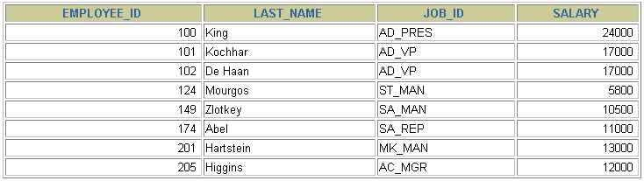
Using the OR Operator
OR requires either condition to be true.
SELECT employee_id, last_name, job_id, salary
FROM employees
WHERE salary >= 10000
OR job_id LIKE '%MAN%';
Notes:
The OR Operator
In the example, either condition can be true for any record to be selected. Therefore, any employee who has a job ID containing MAN or earns $10,000 or more is selected.
The OR Truth Table
The following table shows the results of combining two expressions with OR:
Instructor Note
Demo: 2_or.sql
Purpose: To illustrate using the OR operator.

Slide 18
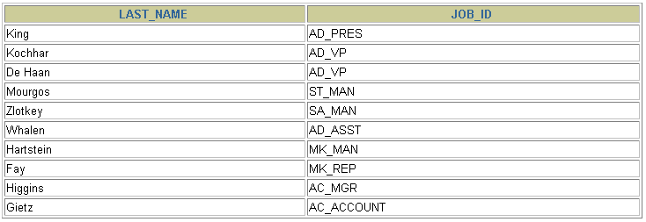
Using the NOT Operator
SELECT last_name, job_id
FROM employees
WHERE job_id
NOT IN ('IT_PROG', 'ST_CLERK', 'SA_REP');
Notes:
The NOT Operator
The slide example displays the last name and job ID of all employees whose job ID is not IT_PROG, ST_CLERK, or SA_REP.
The NOT Truth Table
The following table shows the result of applying the NOT operator to a condition:
Note: The NOT operator can also be used with other SQL operators, such as BETWEEN, LIKE, and NULL.
... WHERE job_id NOT IN ('AC_ACCOUNT', 'AD_VP')
... WHERE salary NOT BETWEEN 10000 AND 15000
... WHERE last_name NOT LIKE '%A%'
... WHERE commission_pct IS NOT NULL

Slide 19
Rules of Precedence
Order Evaluated Operator
1 Arithmetic operators
2 Concatenation operator
3 Comparison conditions
4 IS [NOT] NULL, LIKE, [NOT] IN
5 [NOT] BETWEEN
6 NOT logical condition
7 AND logical condition
8 OR logical condition
Override rules of precedence by using parentheses.
Notes:
Rules of Precedence
The rules of precedence determine the order in which expressions are evaluated and calculated. The table lists the default order of precedence. You can override the default order by using parentheses around the expressions you want to calculate first.

Slide 20
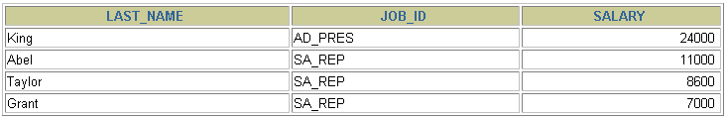
Rules of Precedence
SELECT last_name, job_id, salary
FROM employees
WHERE job_id = 'SA_REP'
OR job_id = 'AD_PRES'
AND salary > 15000;
Notes:
Example of the Precedence of the AND Operator
In the slide example, there are two conditions:
The first condition is that the job ID is AD_PRES and the salary is greater than 15,000.
The second condition is that the job ID is SA_REP.
Therefore, the SELECT statement reads as follows:
“Select the row if an employee is a president and earns more than $15,000, or if the employee is a sales representative.”
Instructor Note
Demo: 2_sal1.sql
Purpose: To illustrate the rules of precedence.

Slide 21
Rules of Precedence
Use parentheses to force priority.
SELECT last_name, job_id, salary
FROM employees
WHERE (job_id = 'SA_REP'
OR job_id = 'AD_PRES')
AND salary > 15000;
Notes:
Using Parentheses
In the example, there are two conditions:
The first condition is that the job ID is AD_PRES or SA_REP.
The second condition is that salary is greater than $15,000.
Therefore, the SELECT statement reads as follows:
“Select the row if an employee is a president or a sales representative, and if the employee earns more than $15,000.”
Instructor Note
Demo: 2_sal2.sql
Purpose: To illustrate the rules of precedence.

Slide 22
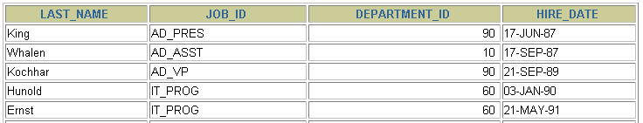
ORDER BY Clause
Sort rows with the ORDER BY clause
ASC: ascending order, default
DESC: descending order
The ORDER BY clause comes last in the SELECT statement.
SELECT last_name, job_id, department_id, hire_date
FROM employees
ORDER BY hire_date ;
…
Notes:
The ORDER BY Clause
The order of rows returned in a query result is undefined. The ORDER BY clause can be used to sort the rows. If you use the ORDER BY clause, it must be the last clause of the SQL statement. You can specify an expression, or an alias, or column position as the sort condition.
Syntax
SELECT expr
FROM table
[WHERE condition(s)]
[ORDER BY {column, expr} [ASC|DESC]];
In the syntax:
ORDER BY specifies the order in which the retrieved rows are displayed
ASC orders the rows in ascending order (this is the default order)
DESC orders the rows in descending order
If the ORDER BY clause is not used, the sort order is undefined, and the Oracle server may not fetch rows in the same order for the same query twice. Use the ORDER BY clause to display the rows in a specific order.
Instructor Note
Let the students know that the ORDER BY clause is executed last in query execution. It is placed last unless the FOR UPDATE clause is used.

Slide 23
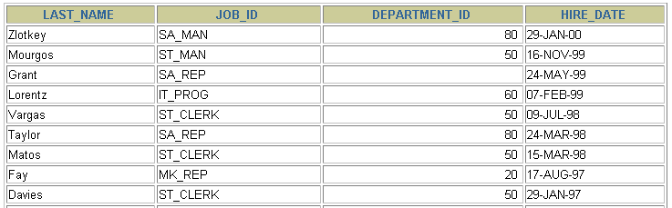
Sorting in Descending Order
SELECT last_name, job_id, department_id, hire_date
FROM employees
ORDER BY hire_date DESC ;
…
Notes:
Default Ordering of Data
The default sort order is ascending:
Numeric values are displayed with the lowest values first—for example, 1–999.
Date values are displayed with the earliest value first—for example, 01-JAN-92 before 01-JAN-95.
Character values are displayed in alphabetical order—for example, A first and Z last.
Null values are displayed last for ascending sequences and first for descending sequences.
Reversing the Default Order
To reverse the order in which rows are displayed, specify the DESC keyword after the column name in the ORDER BY clause. The slide example sorts the result by the most recently hired employee.
Instructor Note
Let the students know that you can also sort by a column number in the SELECT list. The following example sorts the output in the descending order by salary:
SELECT last_name, salary
FROM employees
ORDER BY 2 DESC;

Slide 24
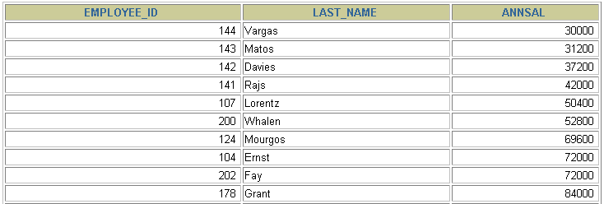
Sorting by Column Alias
SELECT employee_id, last_name, salary*12 annsal
FROM employees
ORDER BY annsal;
…
Notes:
Sorting by Column Aliases
You can use a column alias in the ORDER BY clause. The slide example sorts the data by annual salary.
Instructor Note
Internally, the order of execution for a SELECT statement is as follows:
FROM clause
WHERE clause
SELECT clause
ORDER BY clause

Slide 25
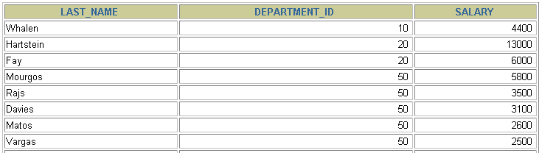
Sorting by Multiple Columns
The order of ORDER BY list is the order of sort.
You can sort by a column that is not in the SELECT list.
SELECT last_name, department_id, salary
FROM employees
ORDER BY department_id, salary DESC;
…
Notes:
Sorting by Multiple Columns
You can sort query results by more than one column. The sort limit is the number of columns in the given table.
In the ORDER BY clause, specify the columns, and separate the column names using commas. If you want to reverse the order of a column, specify DESC after its name. You can also order by columns that are not included in the SELECT clause.
Example
Display the last names and salaries of all employees. Order the result by department number, and then in descending order by salary.
SELECT last_name, salary
FROM employees
ORDER BY department_id, salary DESC;
Instructor Note
Show that the DEPARTMENT_ID column is sorted in ascending order and the SALARY column in descending order.

Slide 26
Summary
In this lesson, you should have learned how to:
Use the WHERE clause to restrict rows of output
Use the comparison conditions
Use the BETWEEN, IN, LIKE, and NULL conditions
Apply the logical AND, OR, and NOT operators
Use the ORDER BY clause to sort rows of output
SELECT *|{[DISTINCT] column|expression [alias],...}
FROM table
[WHERE condition(s)]
[ORDER BY {column, expr, alias} [ASC|DESC]];
Notes:
Summary
In this lesson, you should have learned about restricting and sorting rows returned by the SELECT statement. You should also have learned how to implement various operators and conditions.

Slide 27
Practice 2 Overview
This practice covers the following topics:
Selecting data and changing the order of rows displayed
Restricting rows by using the WHERE clause
Sorting rows by using the ORDER BY clause
Notes:
Practice 2 Overview
This practice gives you a variety of exercises using the WHERE clause and the ORDER BY clause.

Slide 28
Notes:
Practice 2
1. Create a query to display the last name and salary of employees earning more than $12,000. Place your SQL statement in a text file named lab2_1.sql. Run your query.
2. Create a query to display the employee last name and department number for employee number 176.
3. Modify lab2_1.sql to display the last name and salary for all employees whose salary is not in the range of $5,000 and $12,000. Place your SQL statement in a text file named lab2_3.sql.

Slide 29
Notes:
Practice 2 (continued)
4. Display the employee last name, job ID, and start date of employees hired between February 20, 1998, and May 1, 1998. Order the query in ascending order by start date.
5. Display the last name and department number of all employees in departments 20 and 50 in alphabetical order by name.
6. Modify lab2_3.sql to list the last name and salary of employees who earn between $5,000 and $12,000, and are in department 20 or 50. Label the columns Employee and Monthly Salary, respectively. Resave lab2_3.sql as lab2_6.sql. Run the statement in lab2_6.sql.

Slide 30
Notes:
Practice 2 (continued)
7. Display the last name and hire date of every employee who was hired in 1994.
8. Display the last name and job title of all employees who do not have a manager.
9. Display the last name, salary, and commission for all employees who earn commissions. Sort data in descending order of salary and commissions.
If you have time, complete the following exercises:
10. Display the last names of all employees where the third letter of the name is an a.
11. Display the last name of all employees who have an a and an e in their last name.

Slide 31
Notes:
Practice 2 (continued)
If you want an extra challenge, complete the following exercises:
12. Display the last name, job, and salary for all employees whose job is sales representative or stock clerk and whose salary is not equal to $2,500, $3,500, or $7,000.
13. Modify lab2_6.sql to display the last name, salary, and commission for all employees whose commission amount is 20%. Resave lab2_6.sql as lab2_13.sql. Rerun the statement in lab2_13.sql.

